Slide 1

The
Positive Imagery Foundation
“Healthy Families Build Strong Communities”
www.positive-imagery-fnd.org
Notes:
The Positive Imagery Foundation

Slide 2
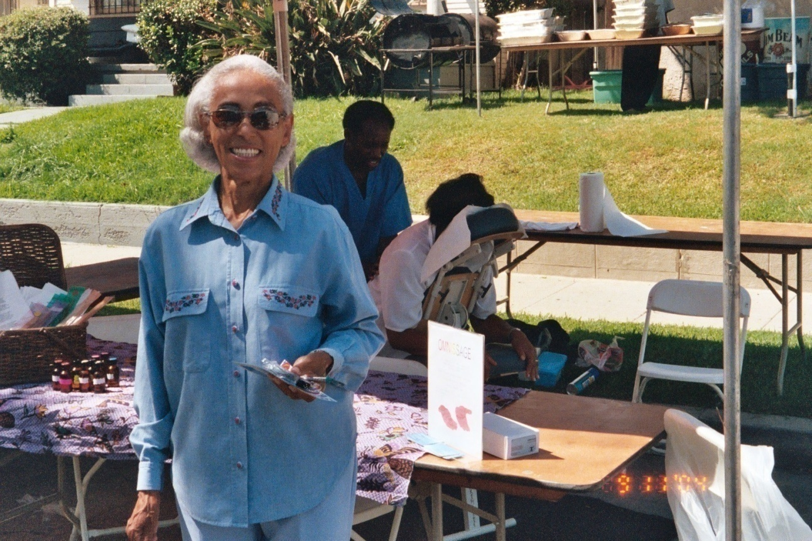
Seventh 7th Ave. Family
www.positive-imagery-fnd.org
Notes:
Our Seventh Avenue Elder

Slide 3
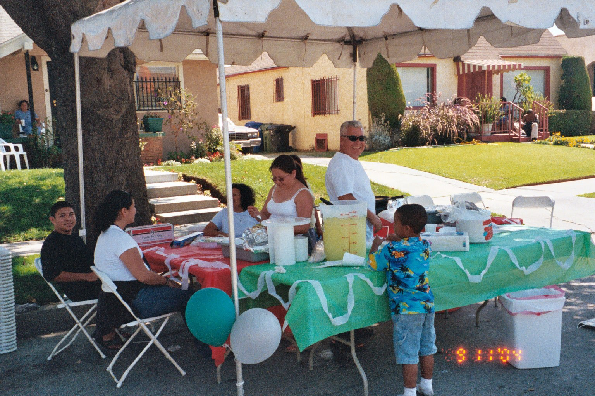
Our 7th Ave. Family Involvement
“The Hernandez’s”
Notes:
Hernandez Family

Slide 4
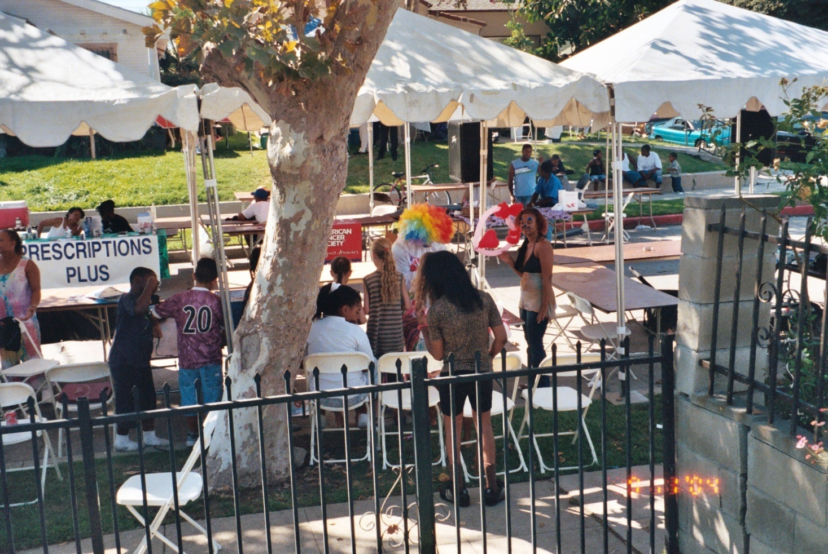
Our Health/Block Gathering
Notes:
Our 4th Annual Block Party 9-11-2004

Slide 5
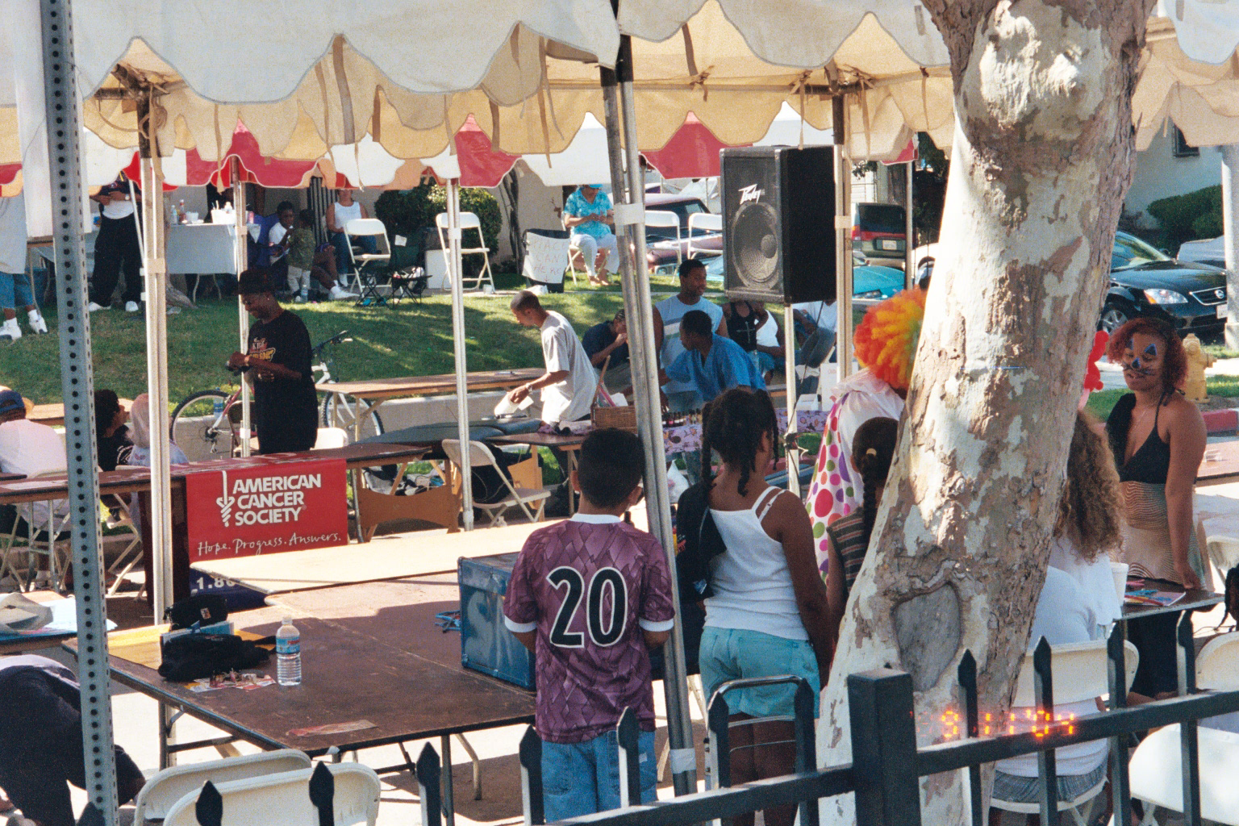
We Promote Healthy Families
www.positive-imagery-fnd.org
Notes:
Promoting Healthy Families

Slide 6
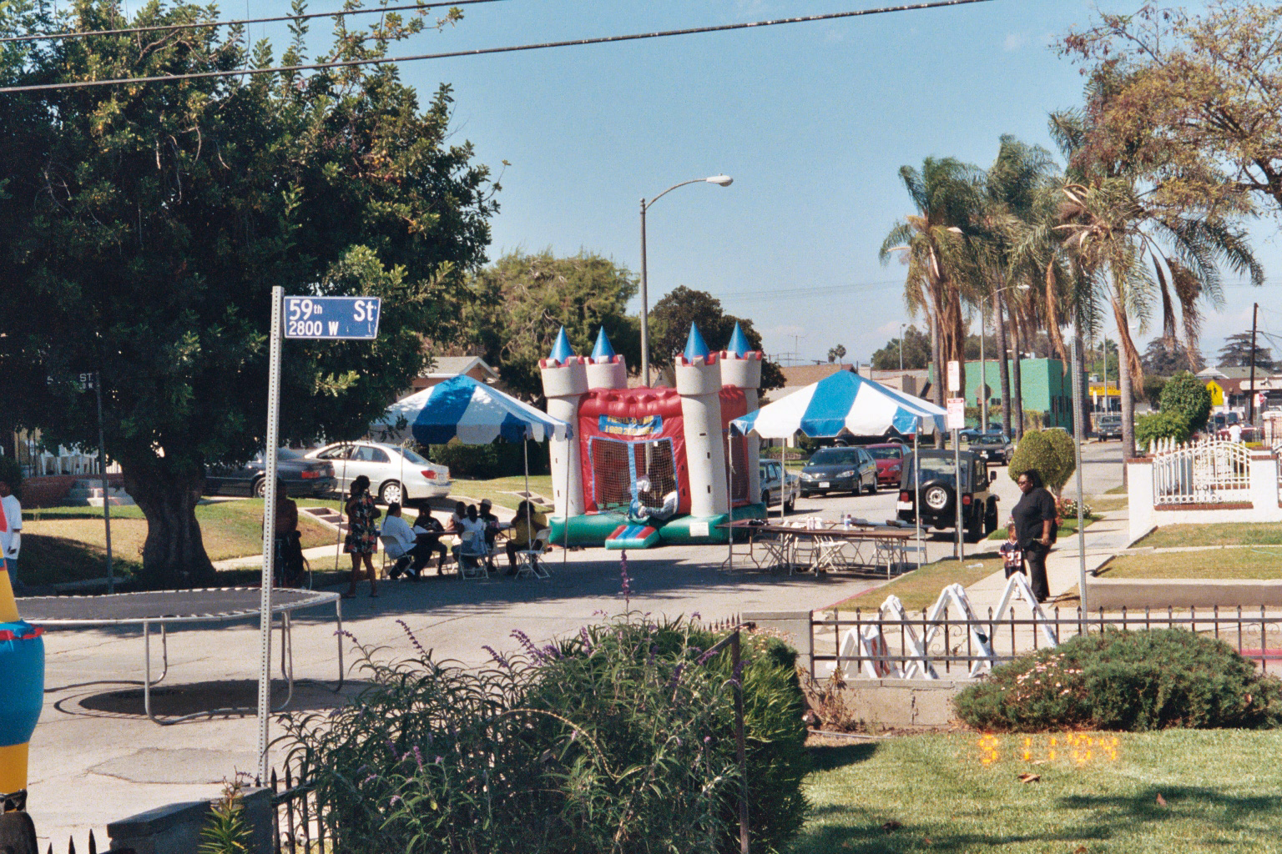
Our Day On 7th Avenue
www.positive-imagery-fnd.org

Slide 7
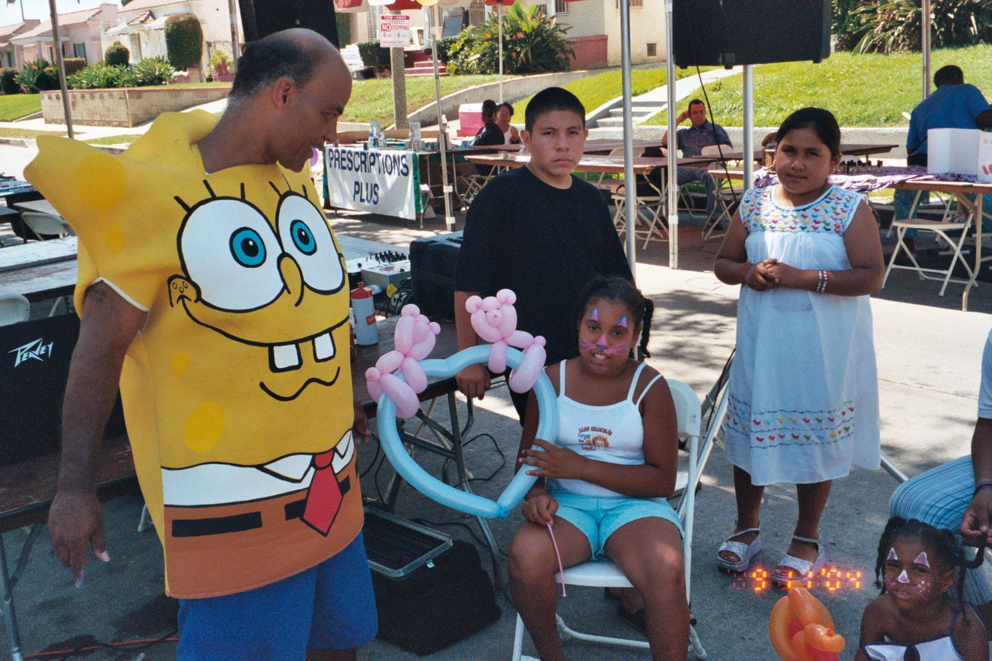
“We Do Care” Says Sponge Bob
Notes:
Sponge Bob Health Fair 9-11-2004

Slide 8
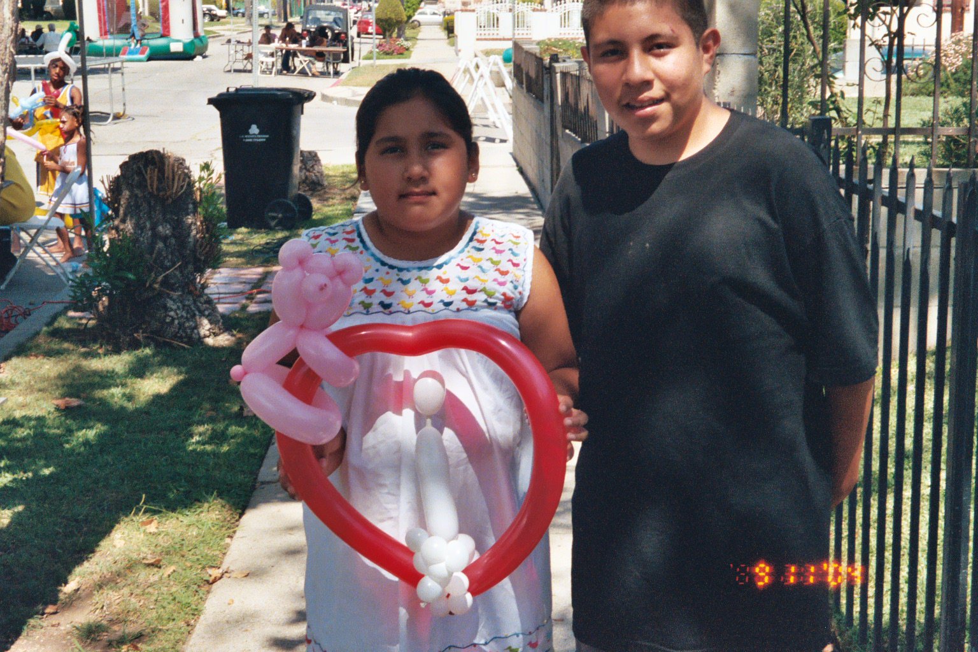
It’s All About Our Caring and Love
Notes:
Hernandez Children

Slide 9
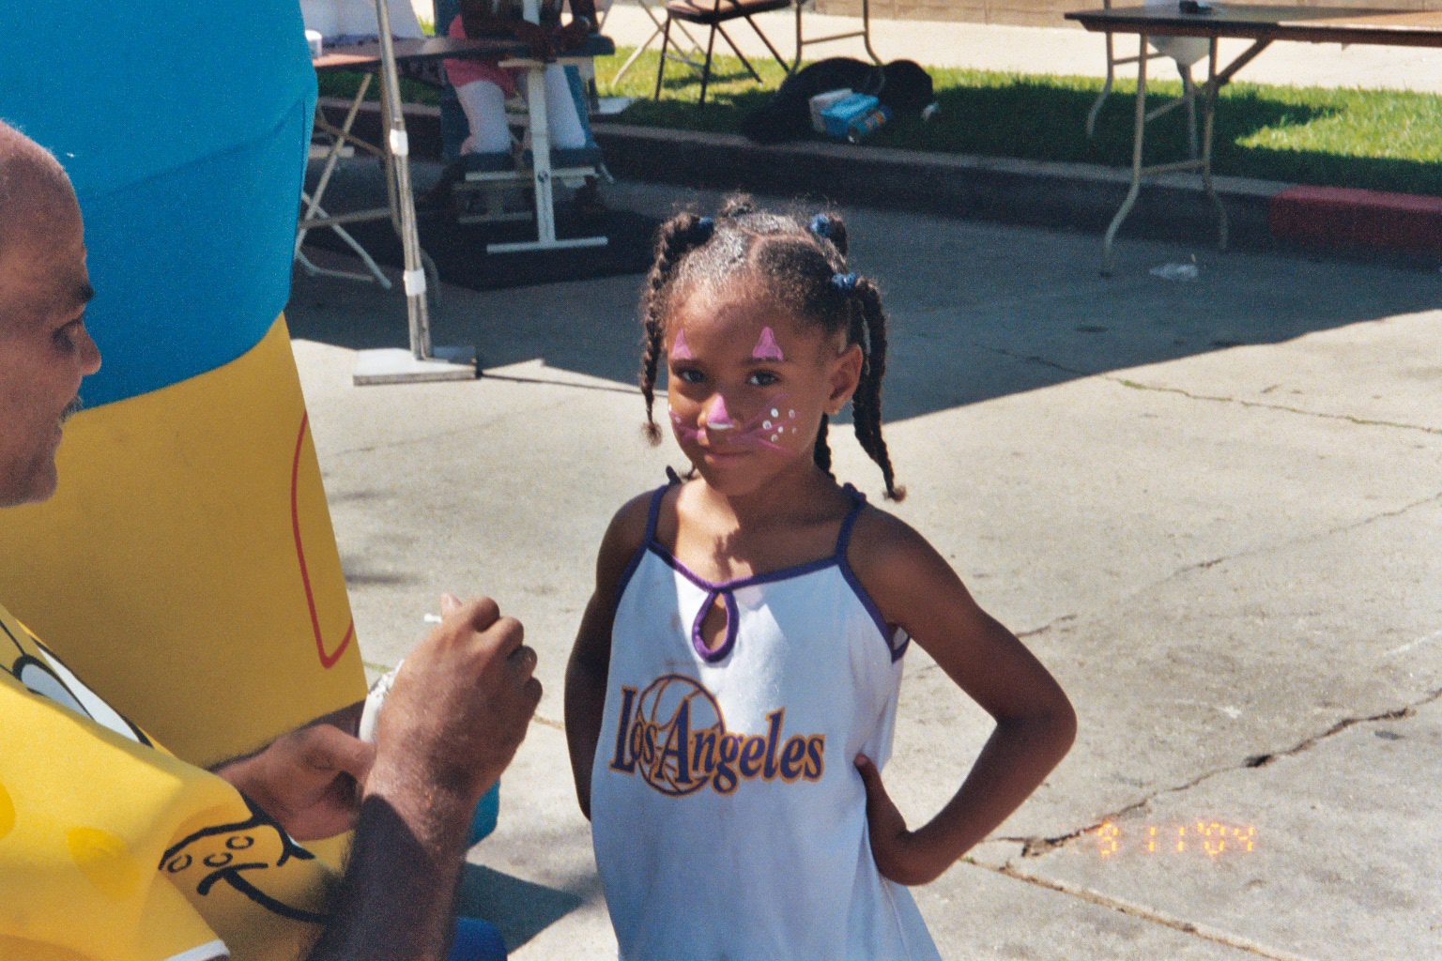
Put On A Happy Face
Notes:
Happy Face

Slide 10
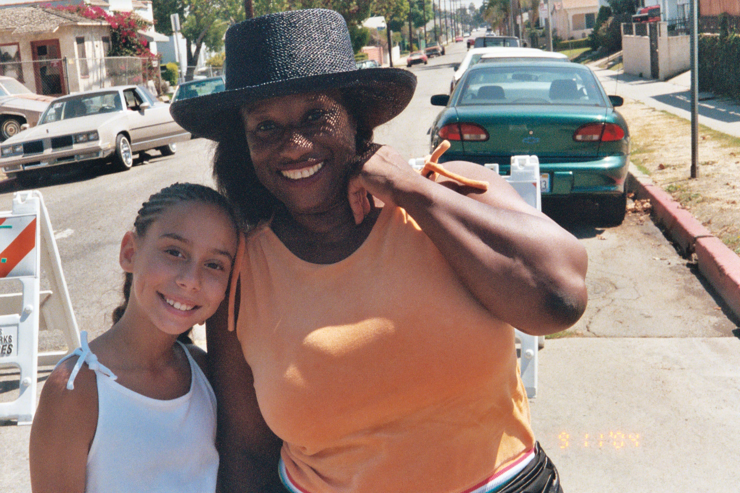
We Give Smiles and LOVE
www.positive-imagery-fnd.org
Notes:
Smiles and Love That’s What We Give

Slide 11
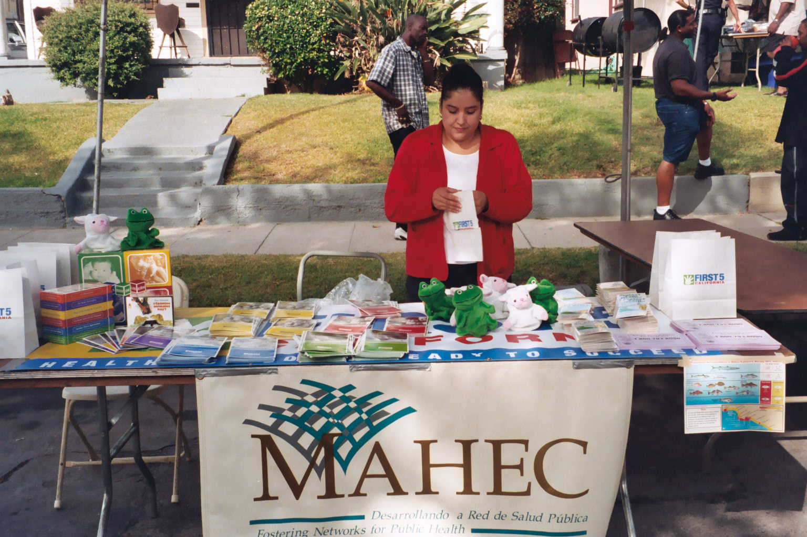
Multi Area Health Ed. Center
www.mahec.org
Notes:
3rd. Annual Health Ed.

Slide 12
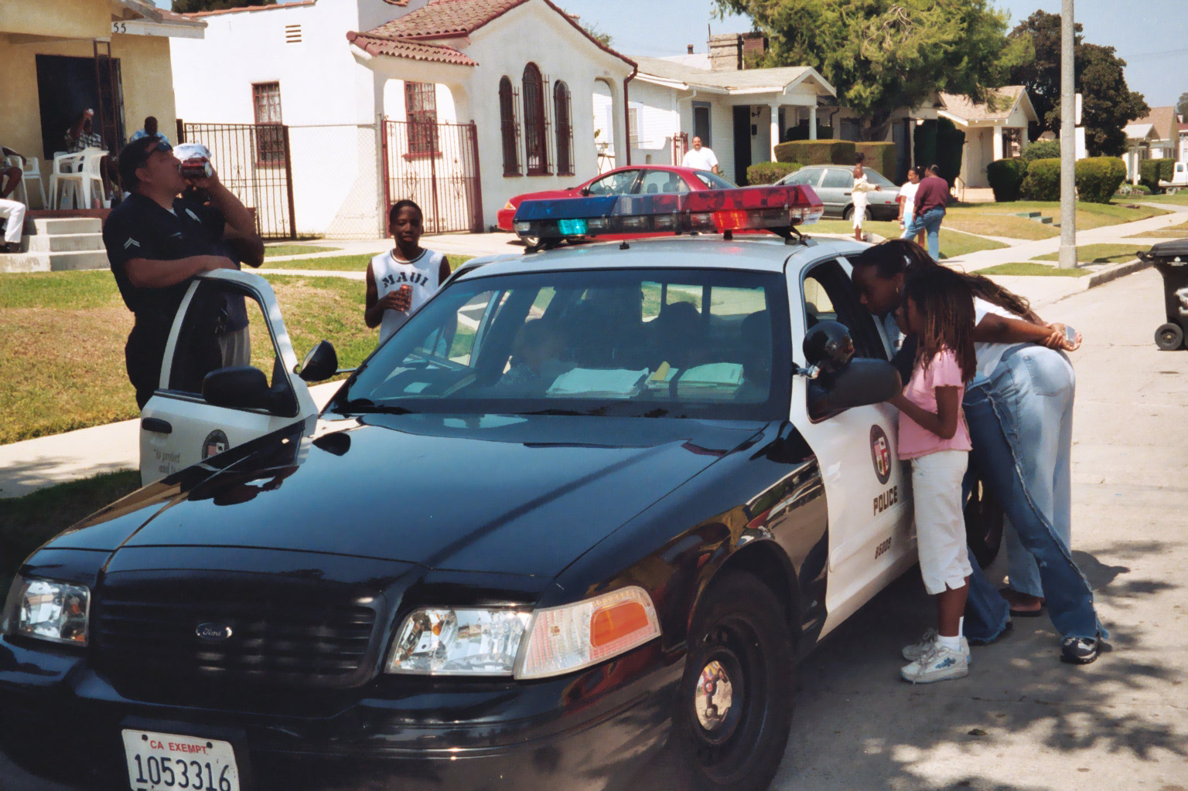
Our 7th Ave. Community Came Together
www.positive-imagery-fnd.org
Notes:
77th Division help bring it all together

Slide 13
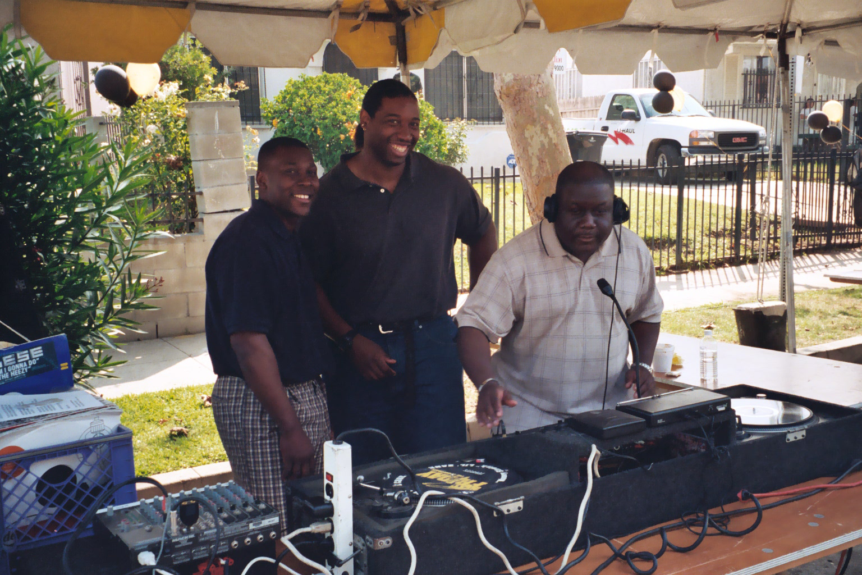
We Had The Music/Support Of Executive Security
Notes:
Executive Security Provided all Security and Music

Slide 14
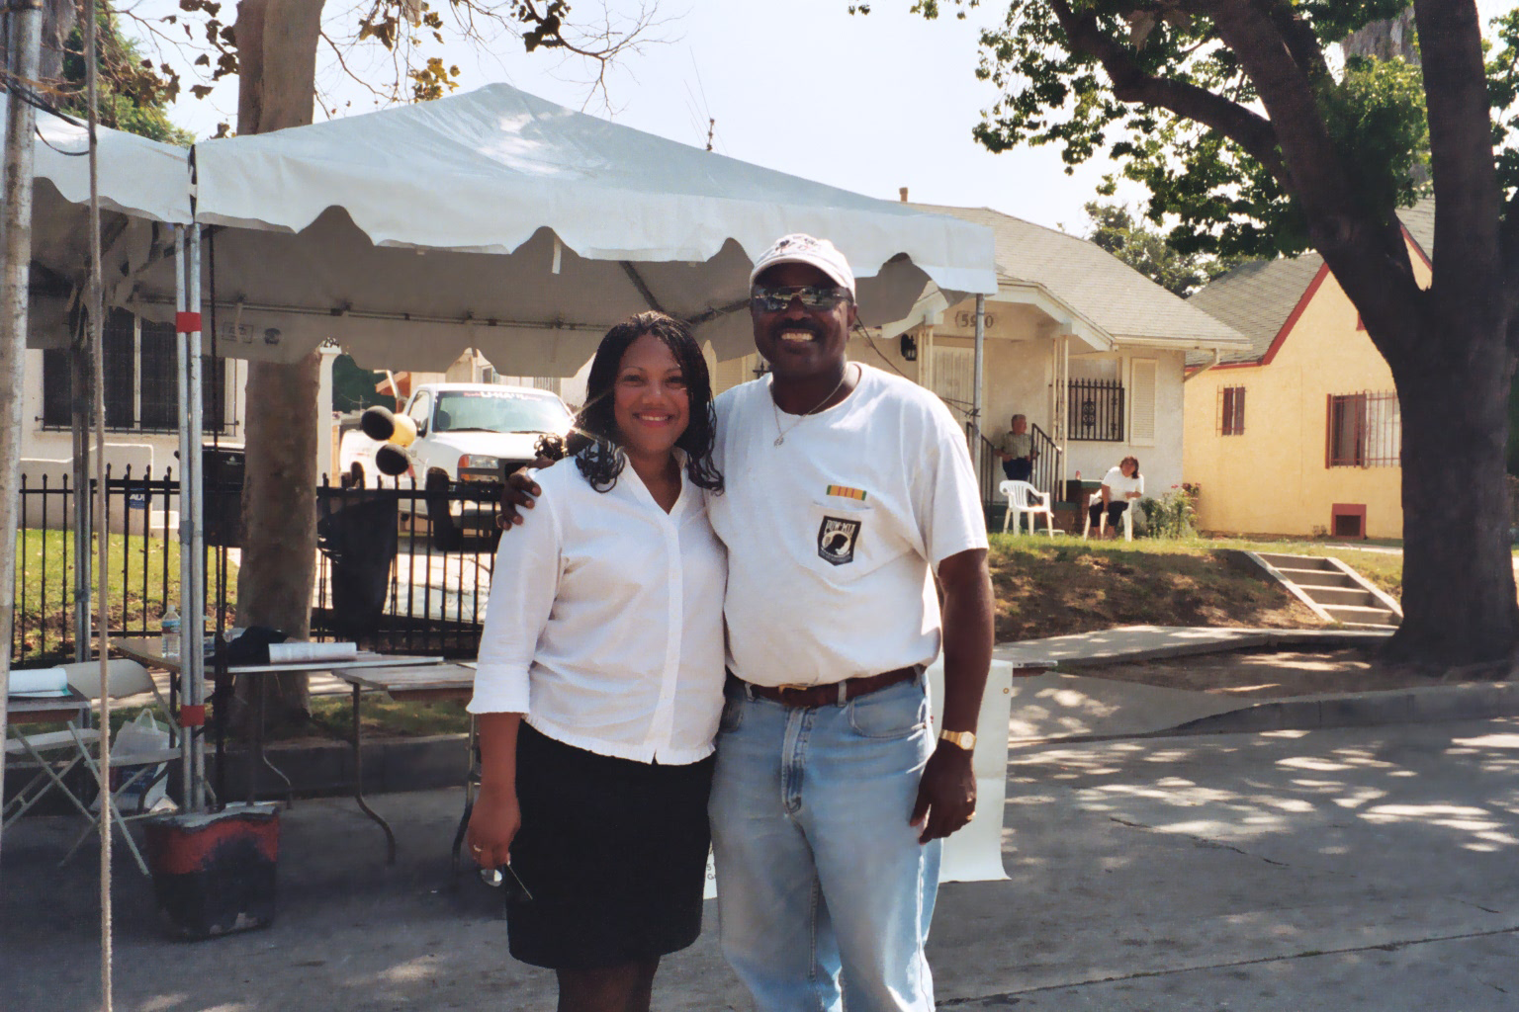
Officials of Our 8th Council District and
Pres/Ceo Dr. Ronald Beavers
www.positive-imagery-fnd.org
Notes:
Representatives From 8th Councilmatic District and Dr. R. Beavers

